Slide 1

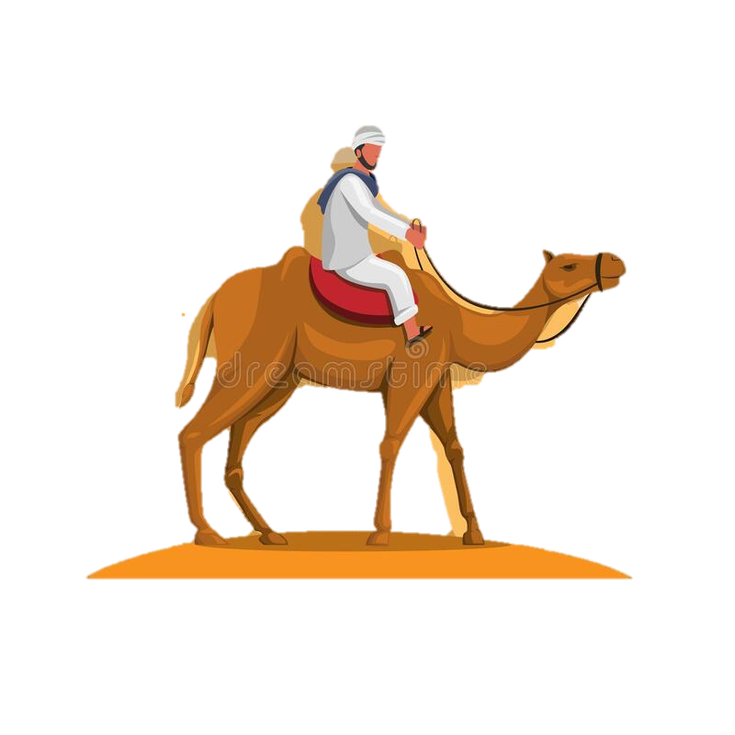
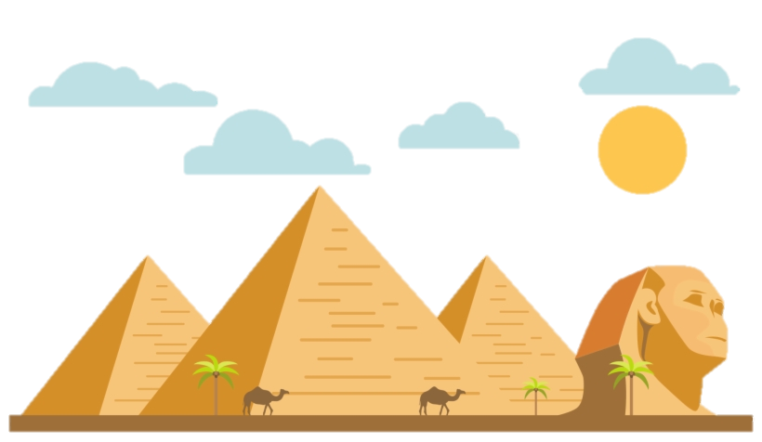
The Giza City
English class presentation 26.11.2021

Slide 2




Our Presentation Timeline
1
2
3
4
Google
Notes
Slides
Present
-We first searched in Google
-Now we are presenting
-Then take notes about important facts
-We made slides according to the notes

Slide 3
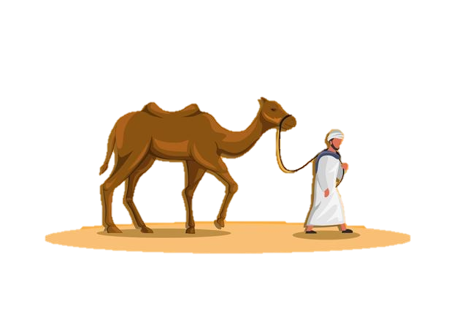
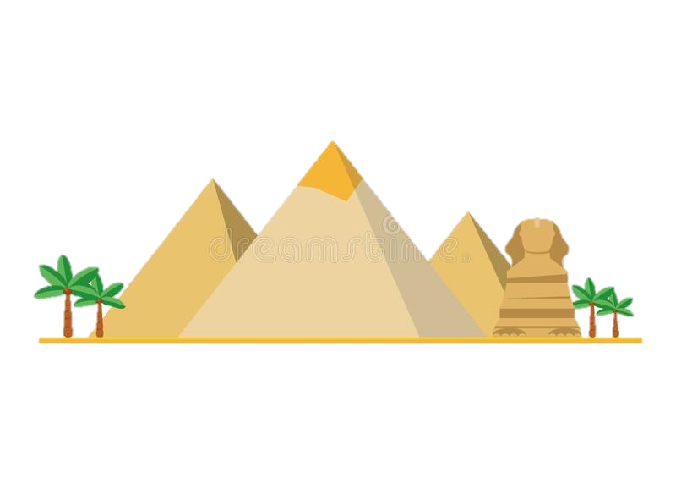
Contents
01
03
02
INTRODUCTION
-We will introduce our team members and how each of as had participated
Famous places
-We will be presenting about the famous places of Giza
About Giza
-We will be presenting about a city named Giza in Egypt

Slide 4
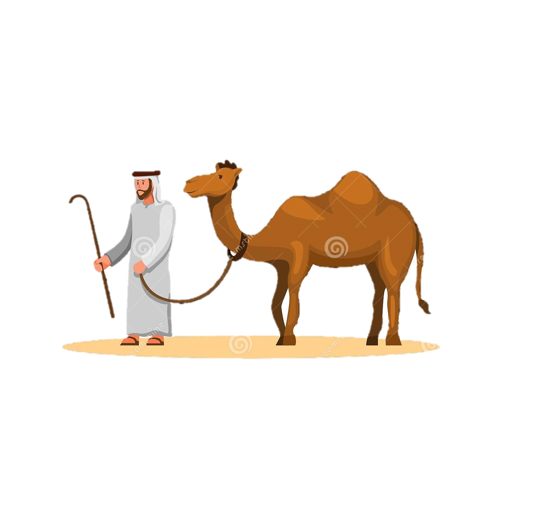
1
Introduction
Our team members introduction

Slide 5





About our team
Hay Thi Lin Oo
(Team Leader)
Lin Phone Myat Kyaw
(Team Member)
Khin Myat Maw
(Team Member)
La Min Eain
(Team Member)
Min Khant Ko
(Team Member)

Slide 6
2
About Giza City
About a city in Egypt

Slide 7
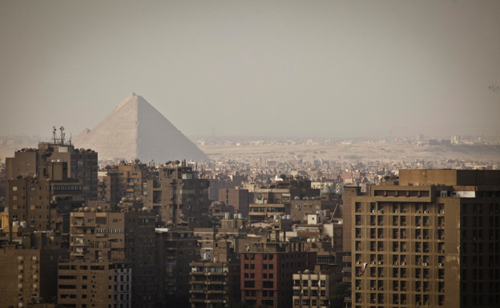
What is Giza City?
-an Egyptian city and second largest city in Egypt.
-Fourth largest city in Africa
-Population is 8.8. million in October 2018
-Founded in 642 AD
-Has a Subtropical Desert climate

Slide 8
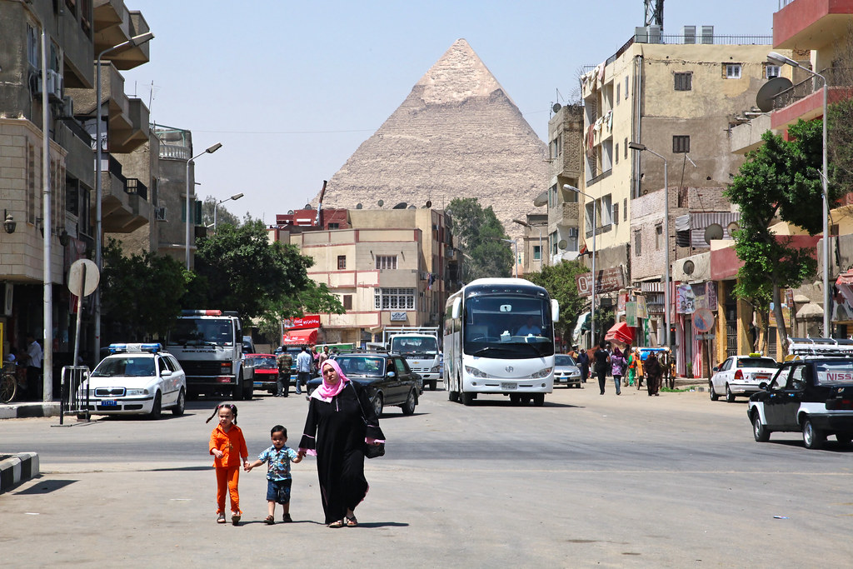
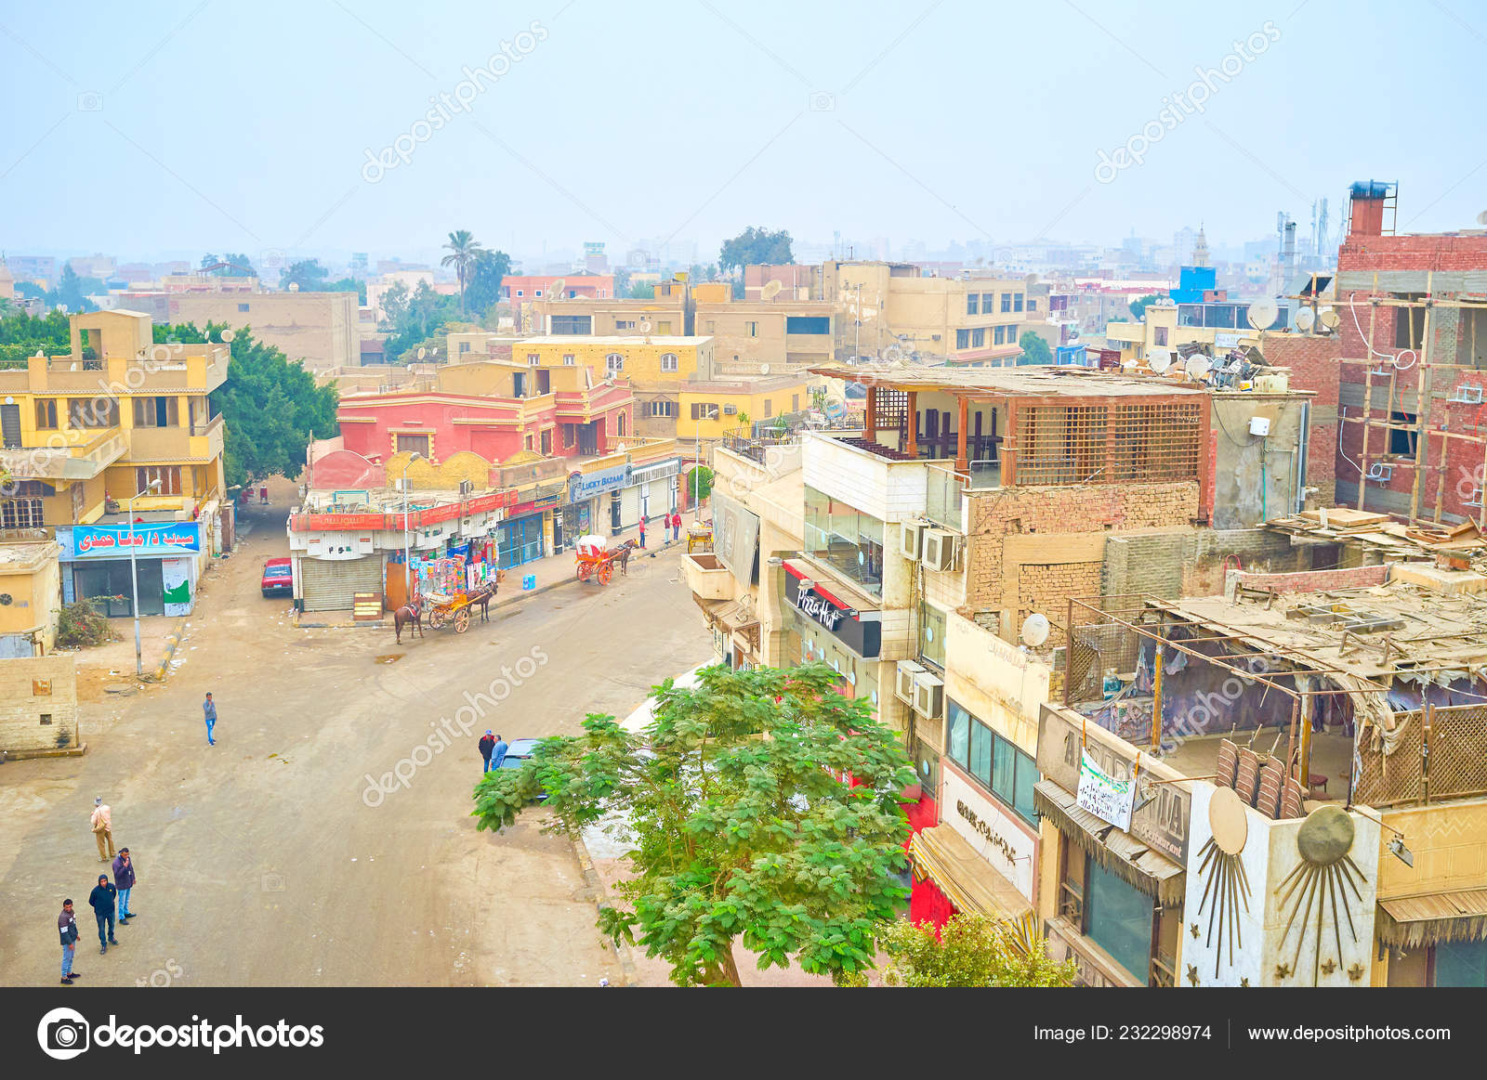
Giza City Nowadays
Flickr.com
Depositphotos.com

Slide 9
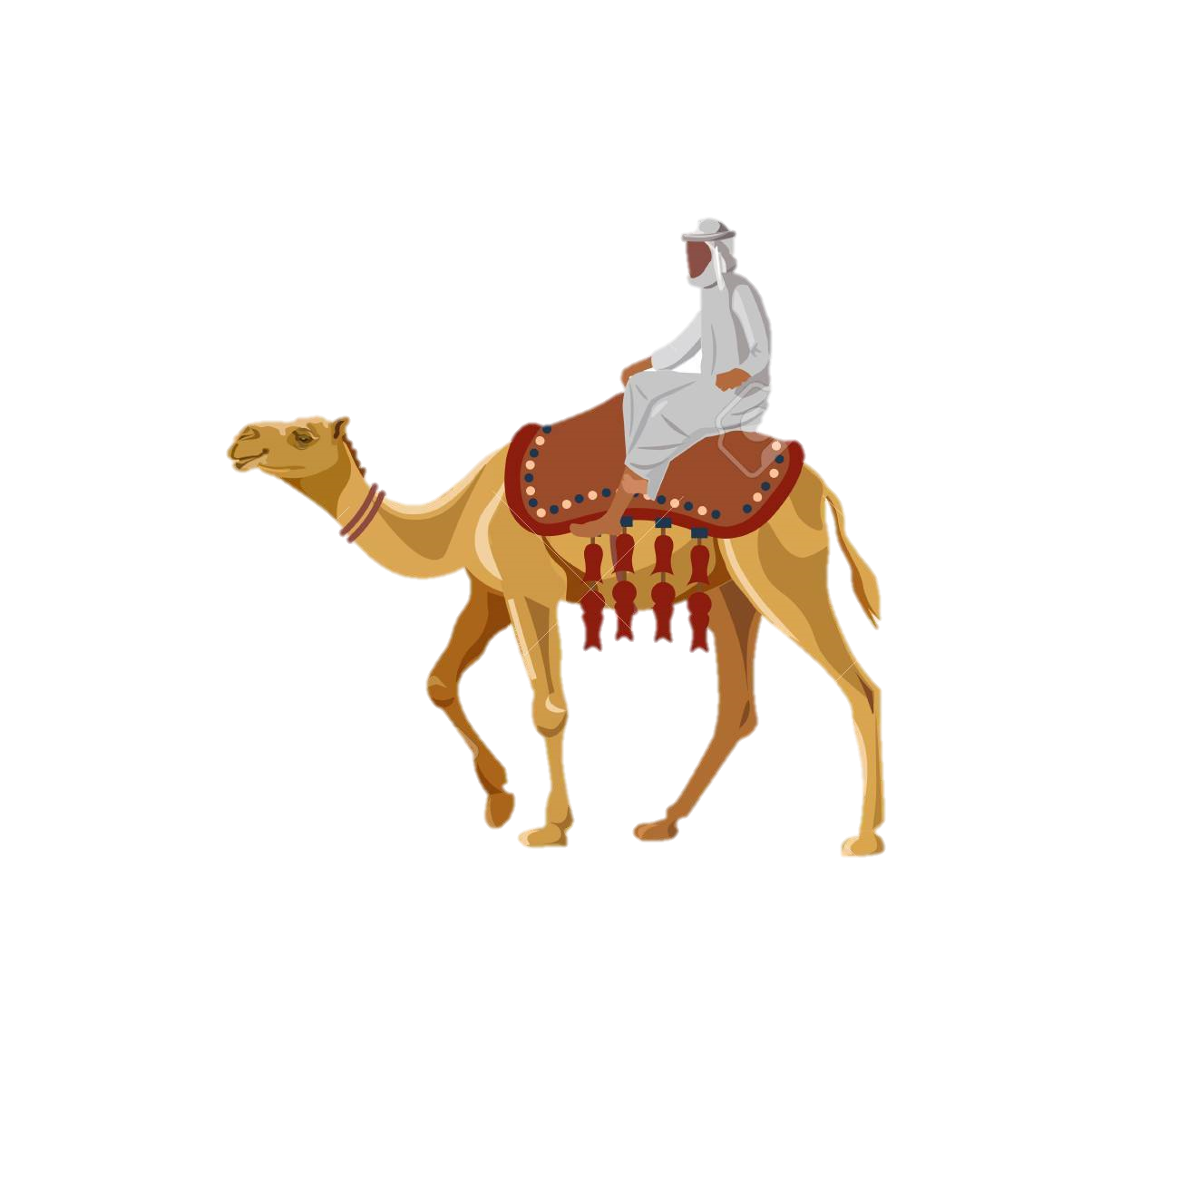
3
Famous places
Places which are good to travel

Slide 10
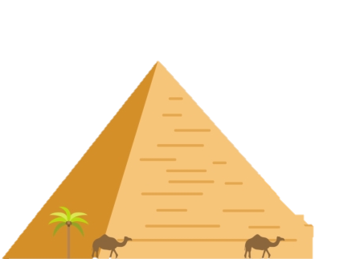
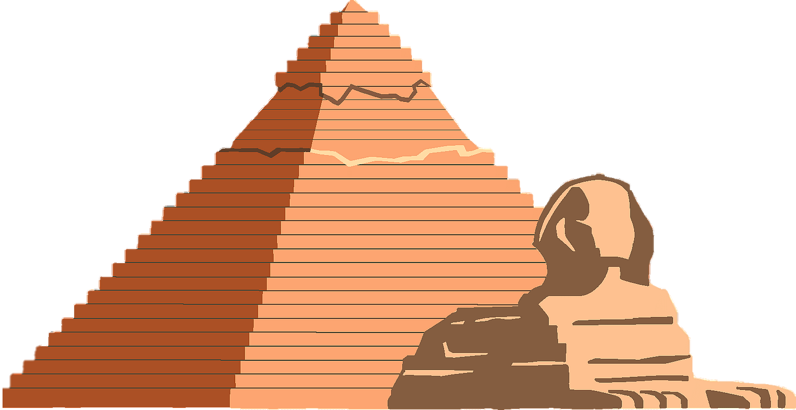
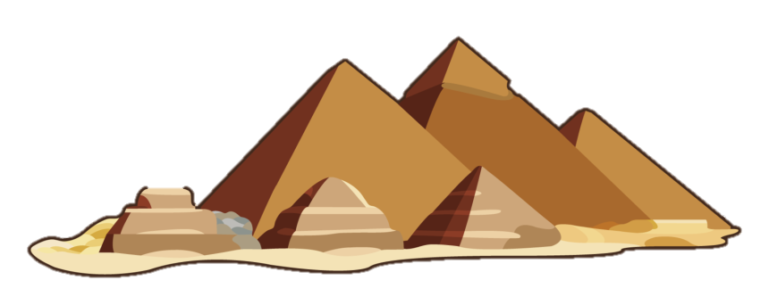
Three Famous Places
1
2
3
Pyramid of Khufu
Pyramid of Khafre
Pyramid of Menkaure

Slide 11
3.1
Pyramid of Khufu
About the pyramid of Khufu aka great pyramid of Giza

Slide 12
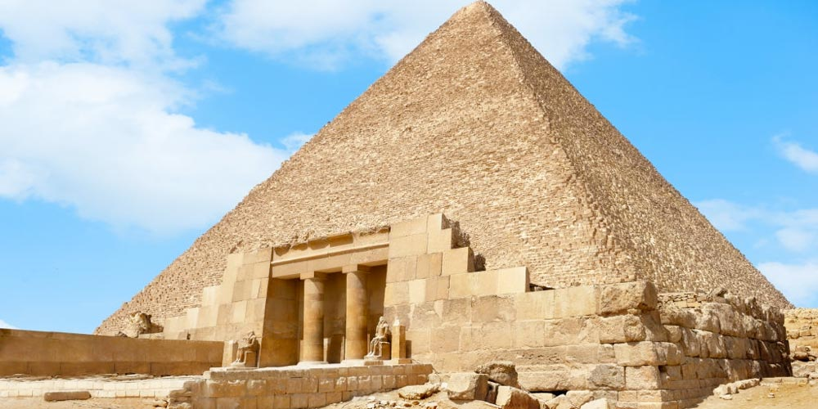
Pyramid of Khufu
-Erected on a rocky plateau on the west bank of the Nile River near Giza in northern Egypt.
-The oldest and largest of the pyramids in the Giza pyramid complex.
-The oldest of seven wonders of the ancient world an the only one to remain largely intact.
-Estimated that it was built in 2600 BC
-Material is mainly limestone, mortar and some granite
-Built by quarrying an estimated 2.3 million large
blocks weighting 6 million tons total.

Slide 13
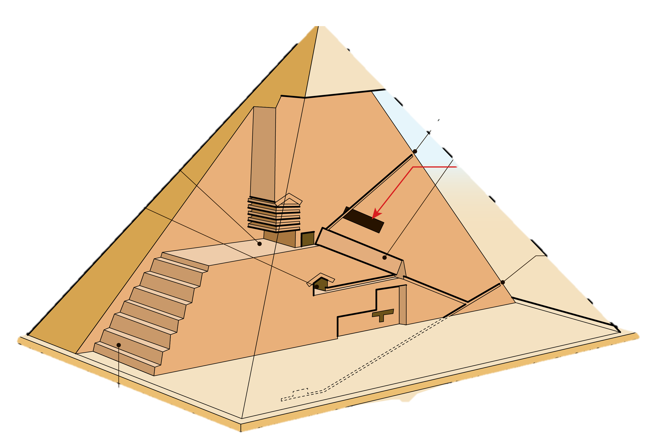
Height of Pyramid of Khufu
-Original Height is 146.6 m, 481 ft or 280 cubits
-Current height is 138.5 m, 454 ft
-Khufu (The King)'s vizier, Hemon is believed by some to be the architect of the Great Pyramid.
-Built for Khufu, the second king of the 4th dynasty.

Slide 14
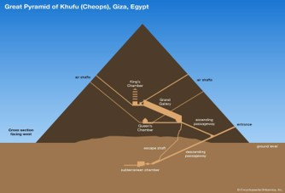
Interior of the Pyramid of Khufu
-There are two known chambers inside the Pyramid, the King’s and the Queen’s.
-They contains a granite sarcophagus, are higher up, within the pyramid structure.
-Determined to be about 4600 years old by two principal approaches.

Slide 15
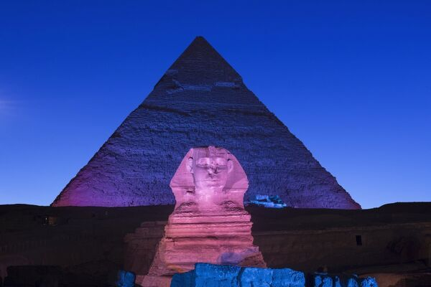
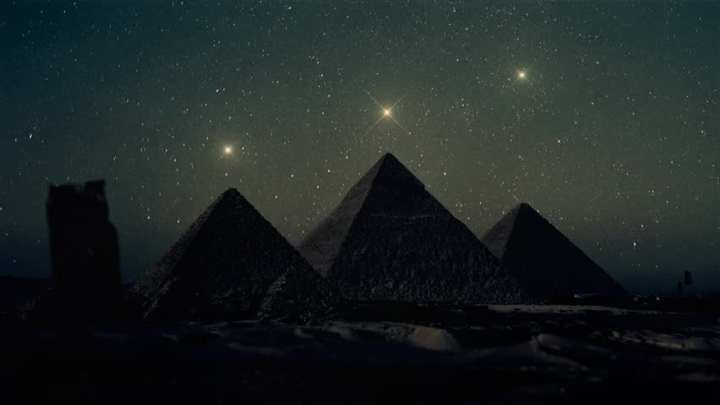
Pyramid of Khufu night views
Shutterstock.com
Mediastorehouse

Slide 16
3.2
Pyramid of Khafre
About the pyramid of Khafre

Slide 17
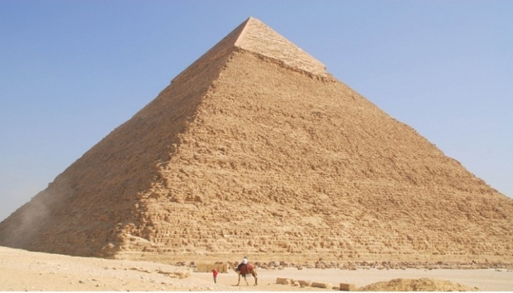
Pyramid of Khafre
-Located southwest of the great pyramid of Khufu, on the Giza plateau outside of Cairo.
-The second-tallest and second-largest of the 3 Ancient Egyptian Pyramids of Giza and the tomb of the Fourth-Dynasty pharaoh Khafre
-Height is 136.4 m, 448 ft
-Made of limestone blocks weighing more than 2 tons each.
-Built under the command of Pharaoh Khafre, who was the son of Khufu.

Slide 18
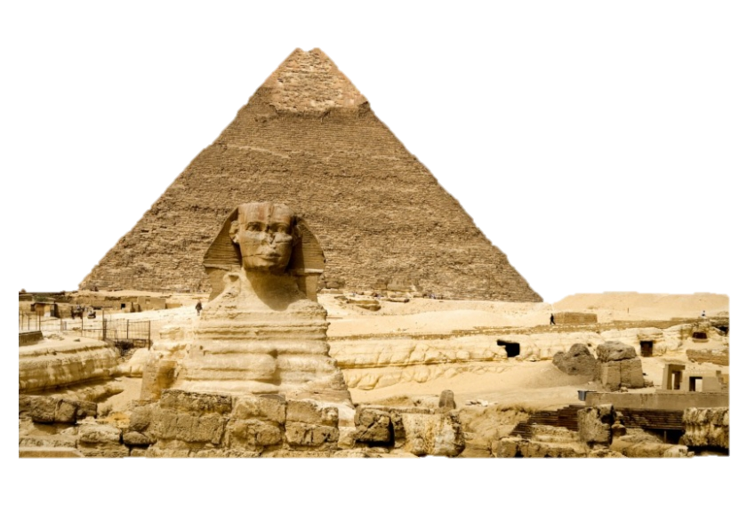
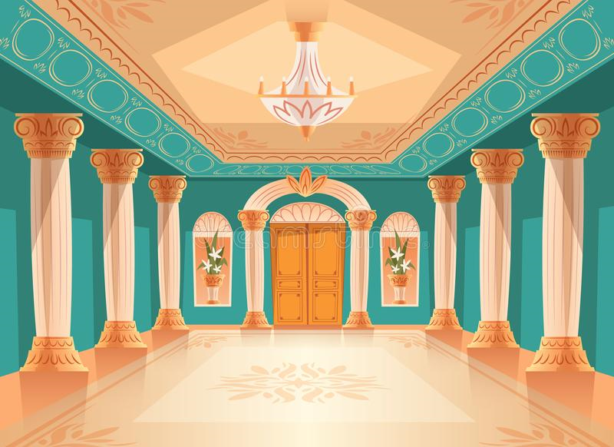
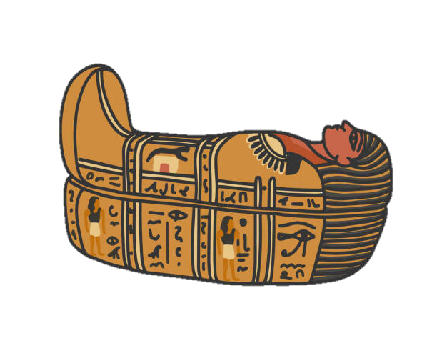
Original purpose of the Pyramid of Khafre
-Later The pyramid was built to its current size, and the tomb was erected on the south side and placed higher.
-First, it was a smaller pyramid blank with a small burial chamber in case a king passed away

Slide 19
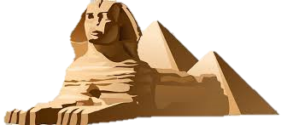
The Sphinx
-A limestone statue of a reclining sphinx, a mythical creature with the head of a man, and the body of a lion.
-Represents the sun god Ra-Horakhty,
-Its face may be of Khafre
-Stands on the Giza Plateau on the west bank of the Nile in Giza, Egypt.
-Height is 19.8 m (65 feet) and length is 73.2 m (240 feet)
-It is the oldest known monumental sculpture in Egypt and one of the most recognizable statues in the world.

Slide 20
3.3
Pyramid of Menkaure
About the pyramid of Menkaure

Slide 21
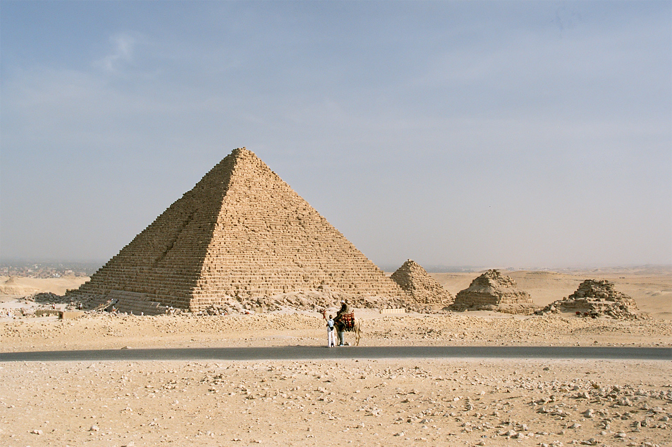
Pyramid of Menkaure
-The smallest of the three main Pyramids of Giza
-Located on the Giza Plateau in the southwestern outskirts of Cairo, Egypt.
-Height is 65 m, 213 ft or 125 cubits
-Constructed with limestone, core, red granite, white limestone and casing
-Have been built to serve as the tomb of the (Fourth Dynasty Egyptian) Pharaoh Menkaure.
-The burial chamber is lined with massive granite blocks.

Slide 22
Why did Egyptians built Pyramids?
Purpose of the Pyramid
-The pyramids were built as tombs and religious purpose.
Who built these Pyramids?
-Were built by Egyptian work crew’s centuries
Who got the idea to build the pyramids?
-Around 2780 BCE, King Djoser's architect, Imhotep, built the first pyramid by placing six masalas, each smaller than the one beneath, in a stack to form a pyramid rising in steps.

Slide 23

Best time to visit Egypt
-The best time to visit Egypt is between October and April
-Temperature are cooler and pleasantly warm in this period of time

Slide 24
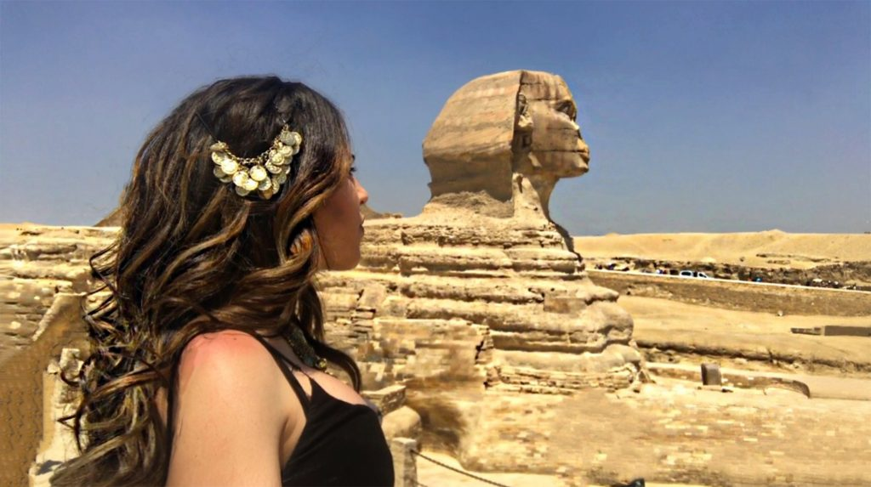
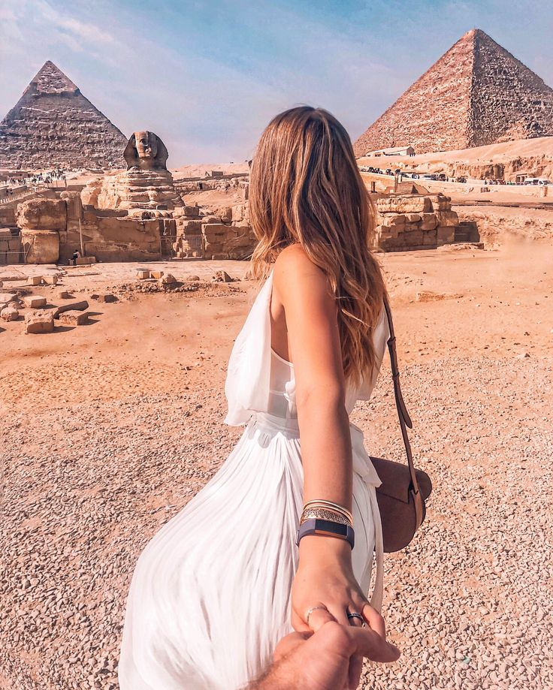
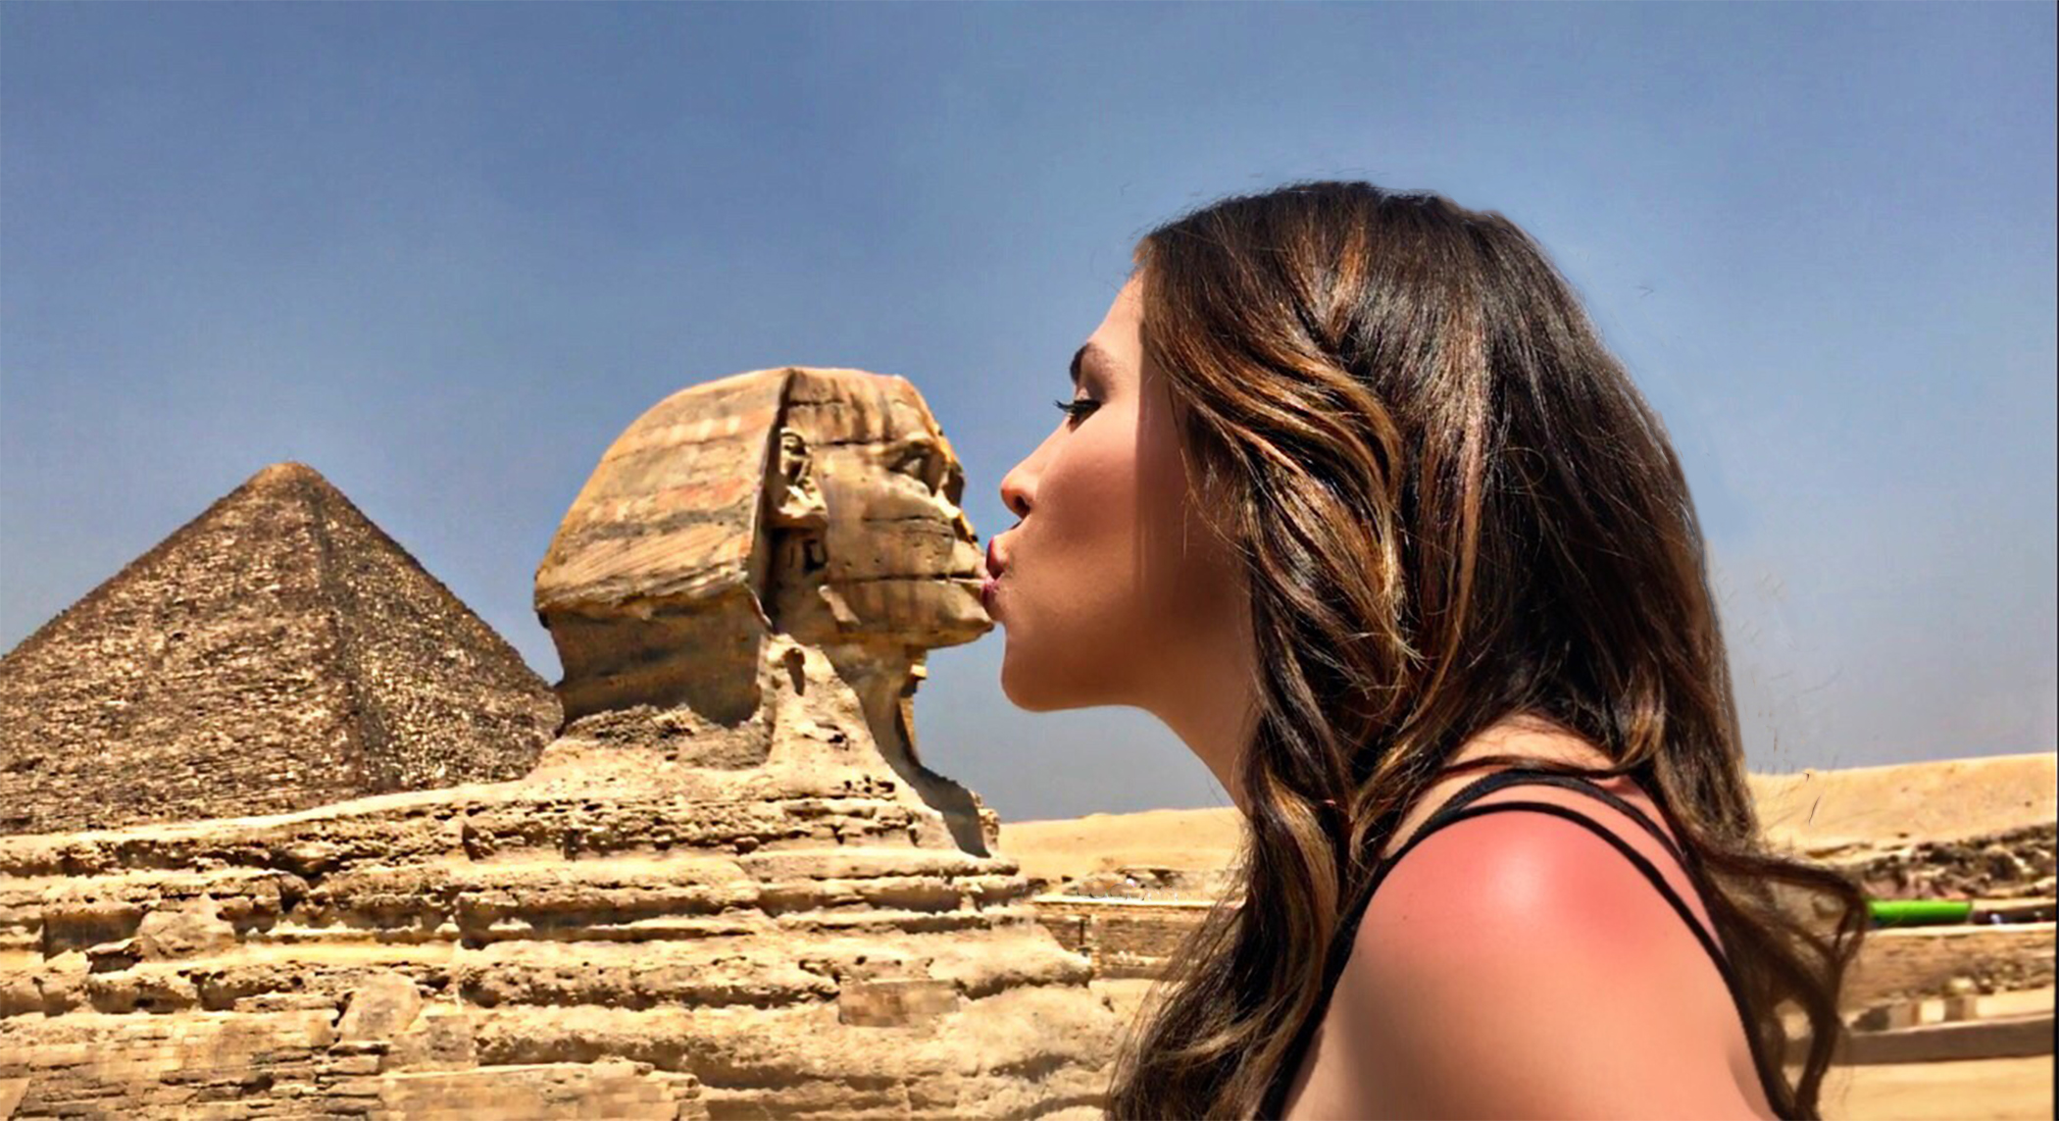
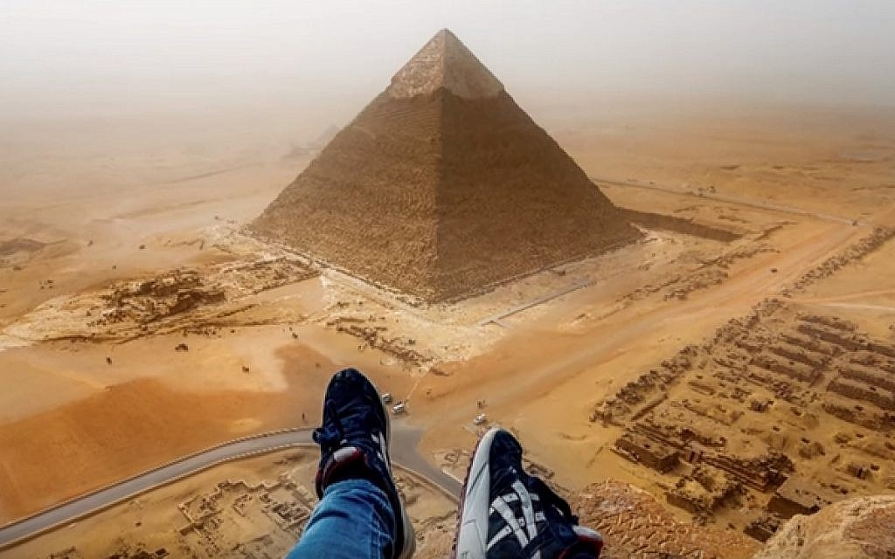
Photo taking ideas with Pyramids
suzieagelopoulos.com
suzieagelopoulos.com
Pinterest.com
thetimesofisrael

Slide 25
Thanks!
Feel free to ask the questions
Please keep this slide for attribution

Slide 26
Resources
VECTORS
Desert landscape - background for video conferencing
Cowboy label set of four
ICONS
Wild West Icon Pack
PHOTOS
Group of people sitting on top of dune
Woman jumping for joy on hilltop
Front view man in casual clothes
Man and woman posing and looking at the camera
Side view woman at home drinking coffee

